Slide 1
Open to New Approaches

Slide 2
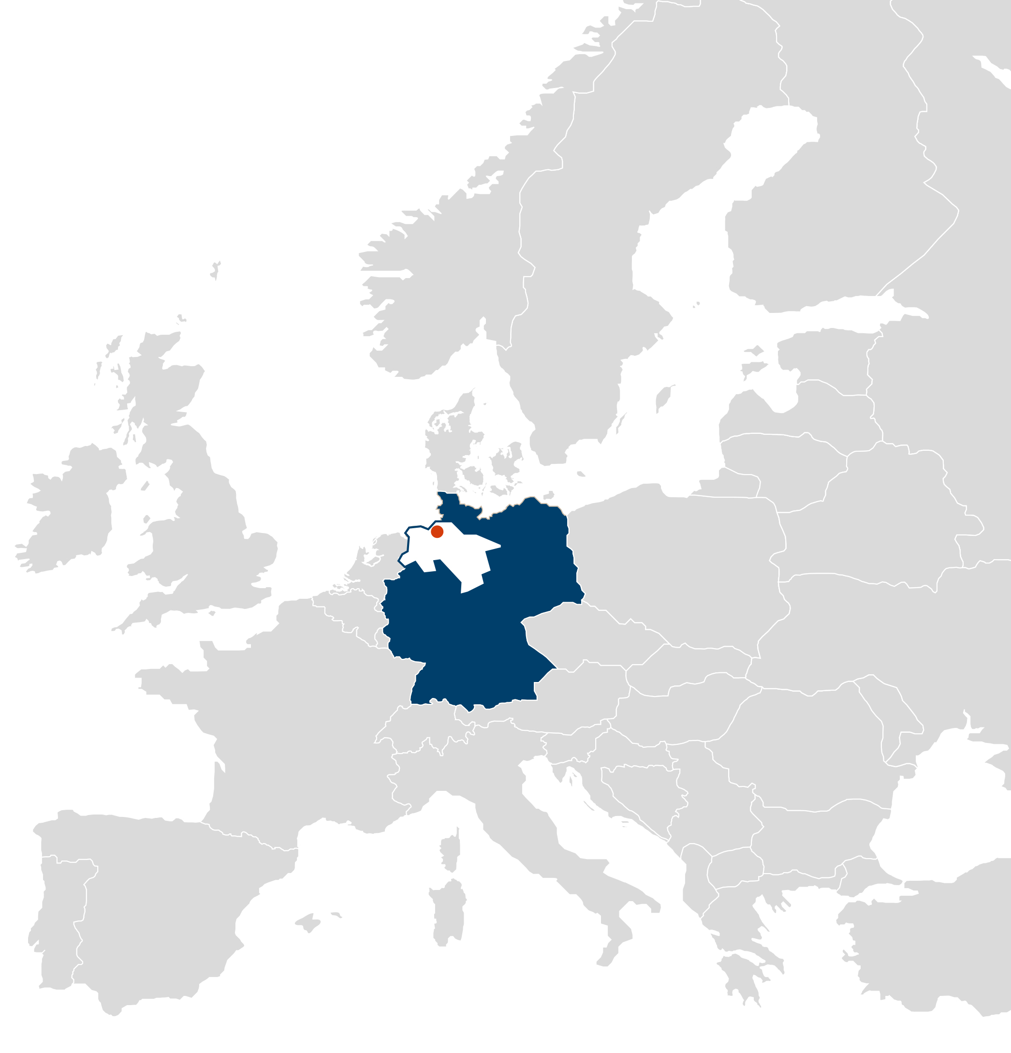
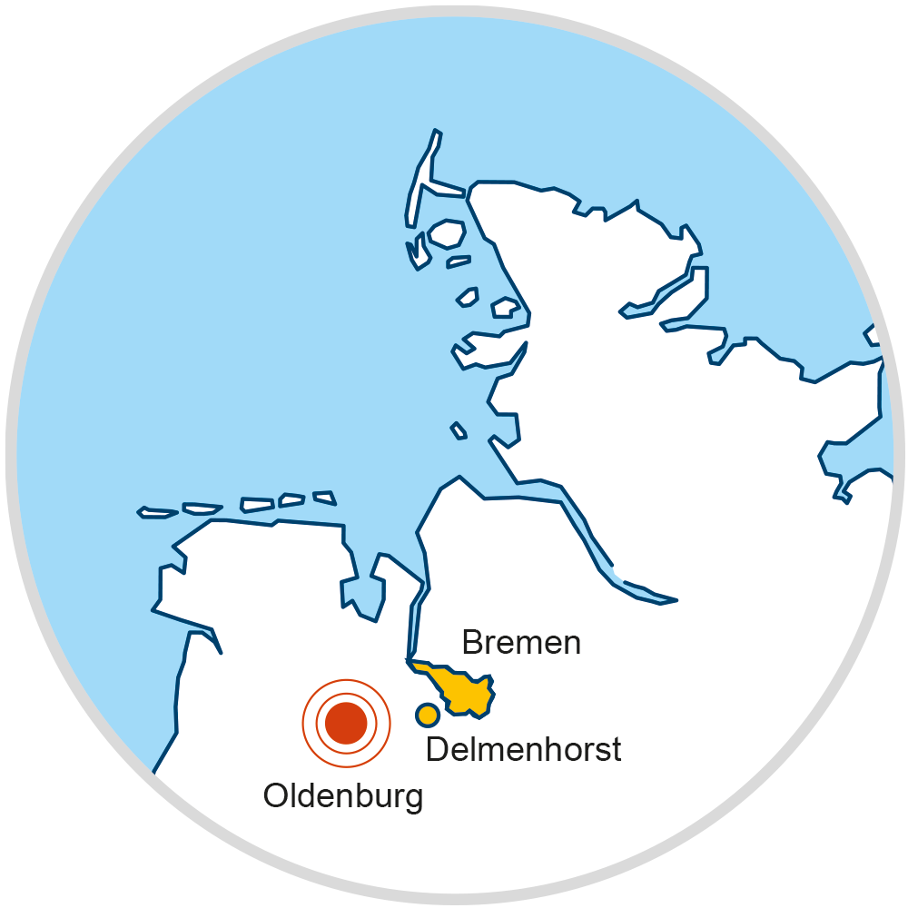

Slide 3
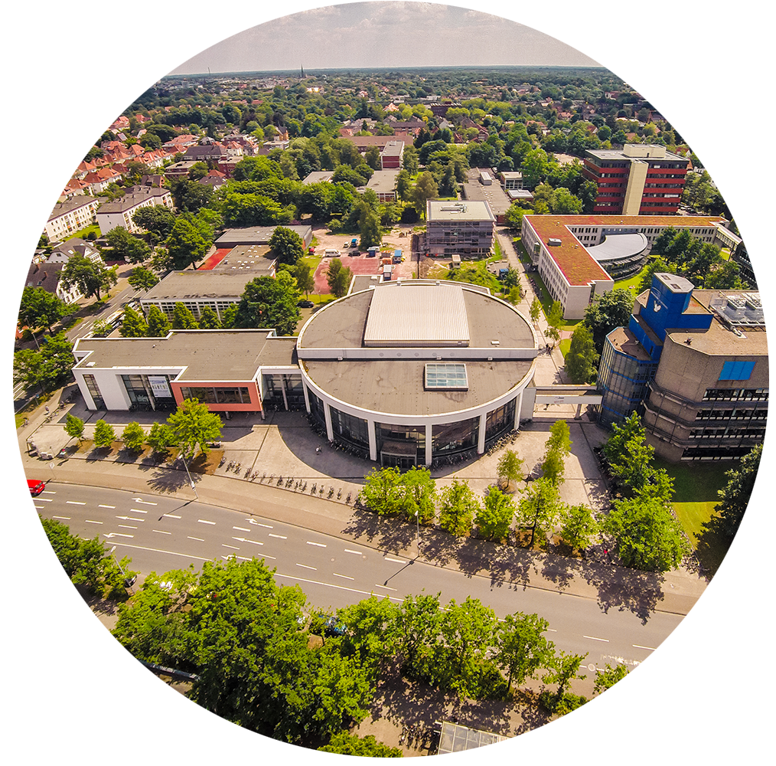
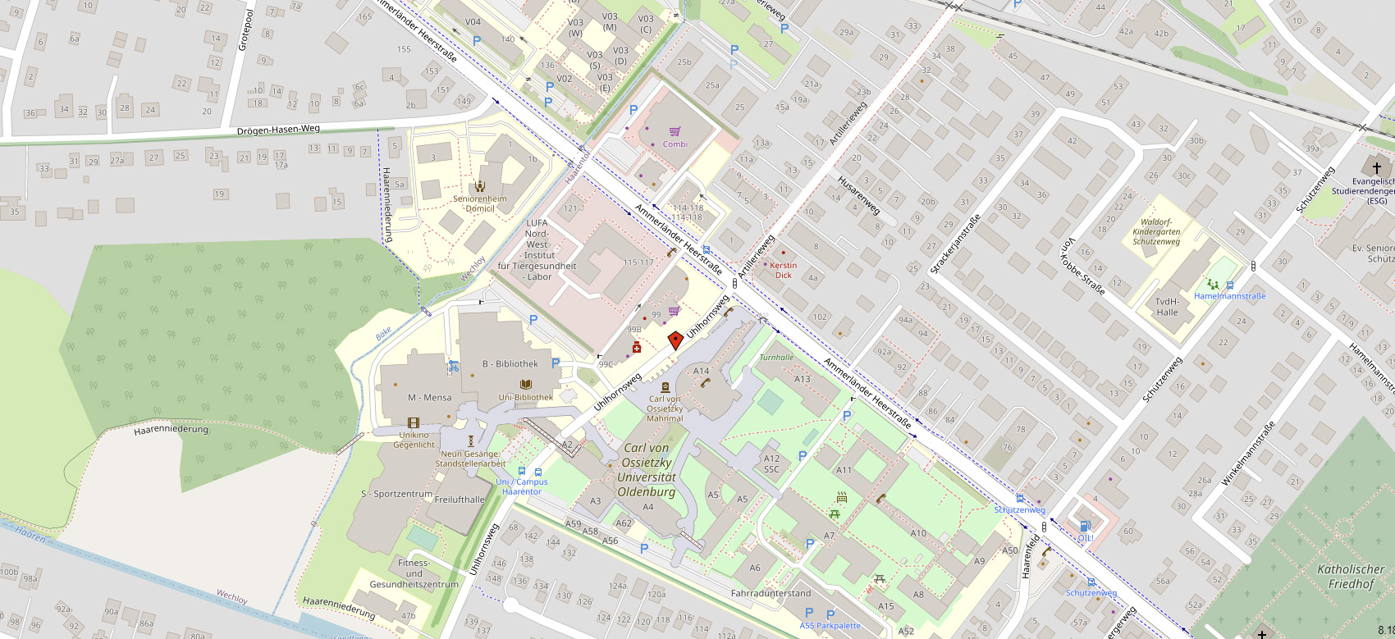
Campus Haarentor

Slide 4
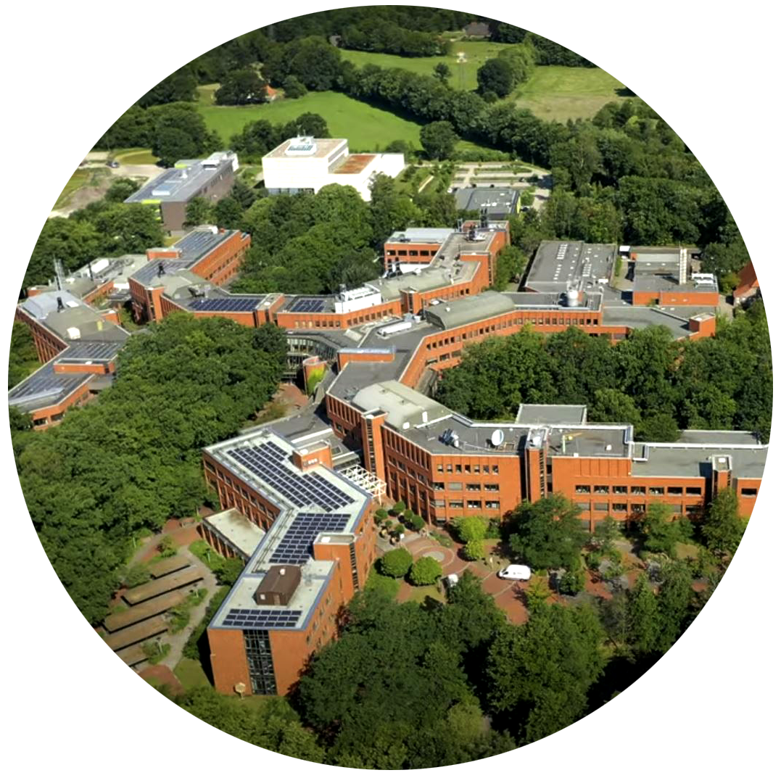
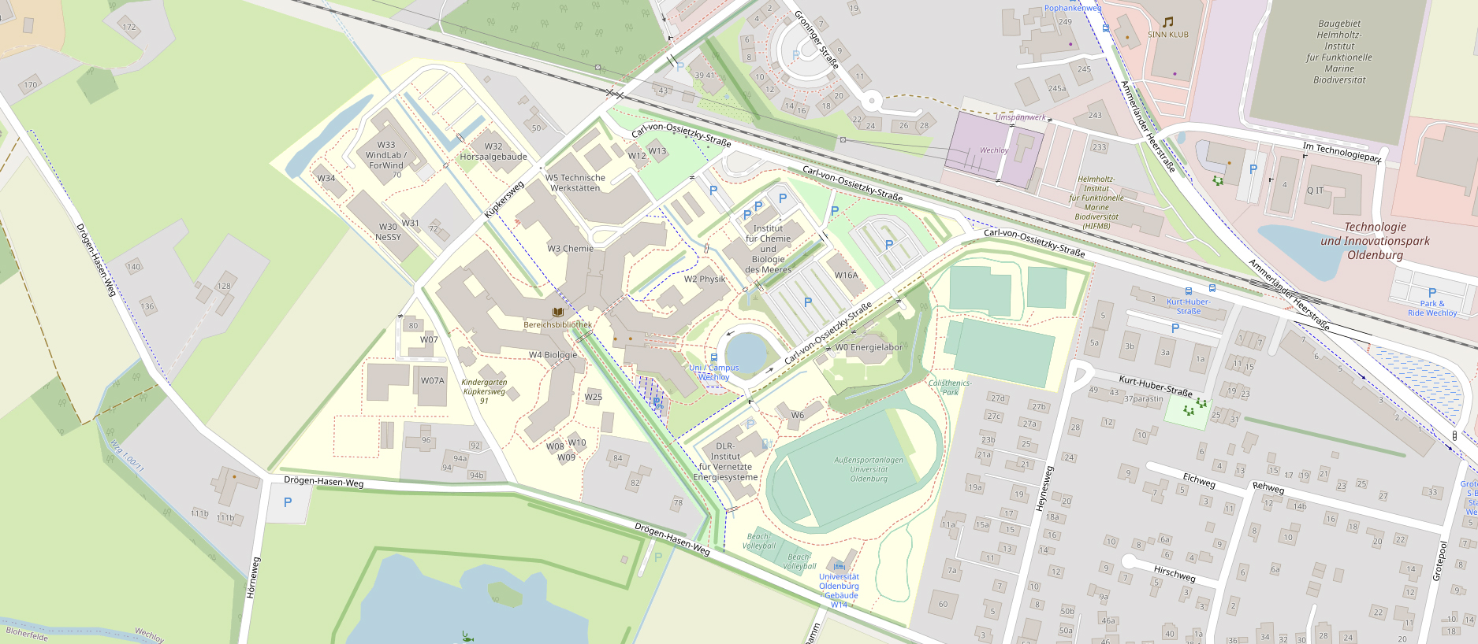
Campus Wechloy

Slide 5
Facts
Around 15,700 students
Around 2,600 employees (including 1,300 academic staff members)
257 professorships

Slide 6
History
1793 A teacher training college is established, which later becomes the Pädagogische Hochschule
1973 The University of Oldenburg is founded and the Pädagogische Hochschule is integrated
1974 Teaching and research activities begin
1991 The University is named after Carl von Ossietzky

Slide 7
The University’s Eponym Carl von Ossietzky (1889 – 1938)
Publisher of the magazine „Weltbühne“
Pacifist and opponent of National Socialism
Nobel Peace Prize laureate 1936
Prisoner at Esterwegen concentration Camp (near Oldenburg)

Slide 8
Schools
School I School of Educational and Social Sciences
School II School of Computing Science, Business Administration, Economics, and Law
School III School of Linguistics and Cultural Studies
School IV School of Humanities and Social Sciences
School V School of Mathematics and Science
School VI School of Medicine and Health Sciences

Slide 9
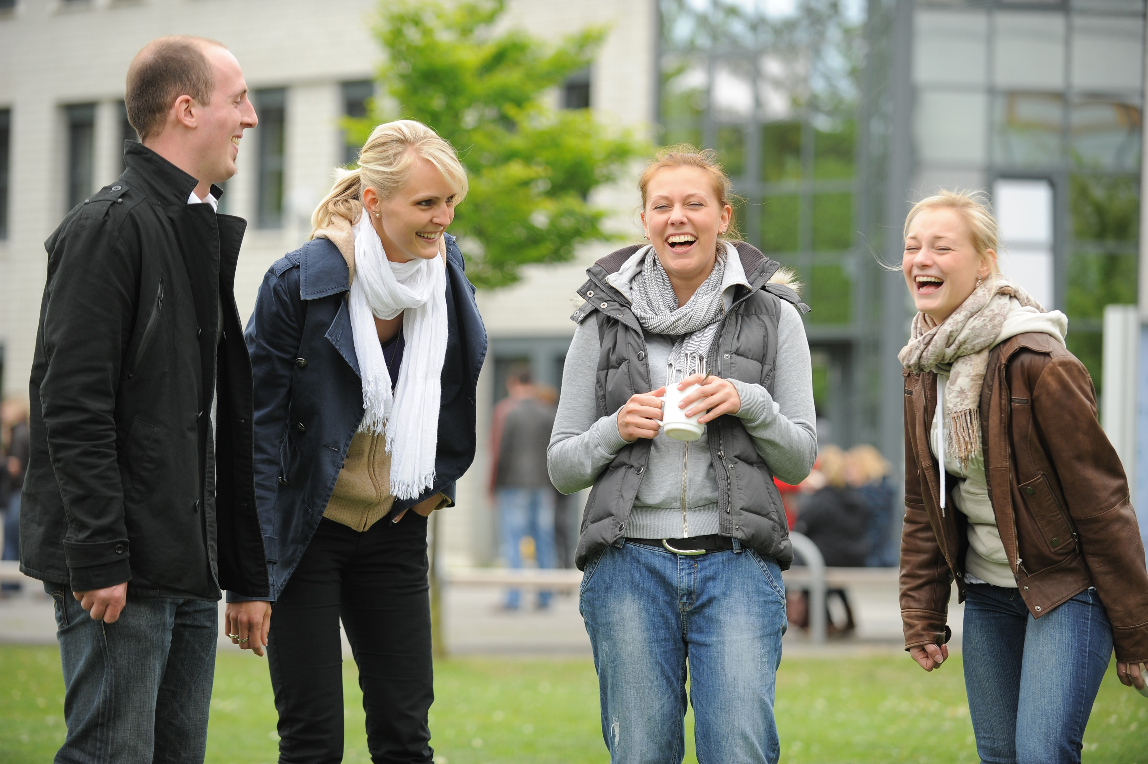
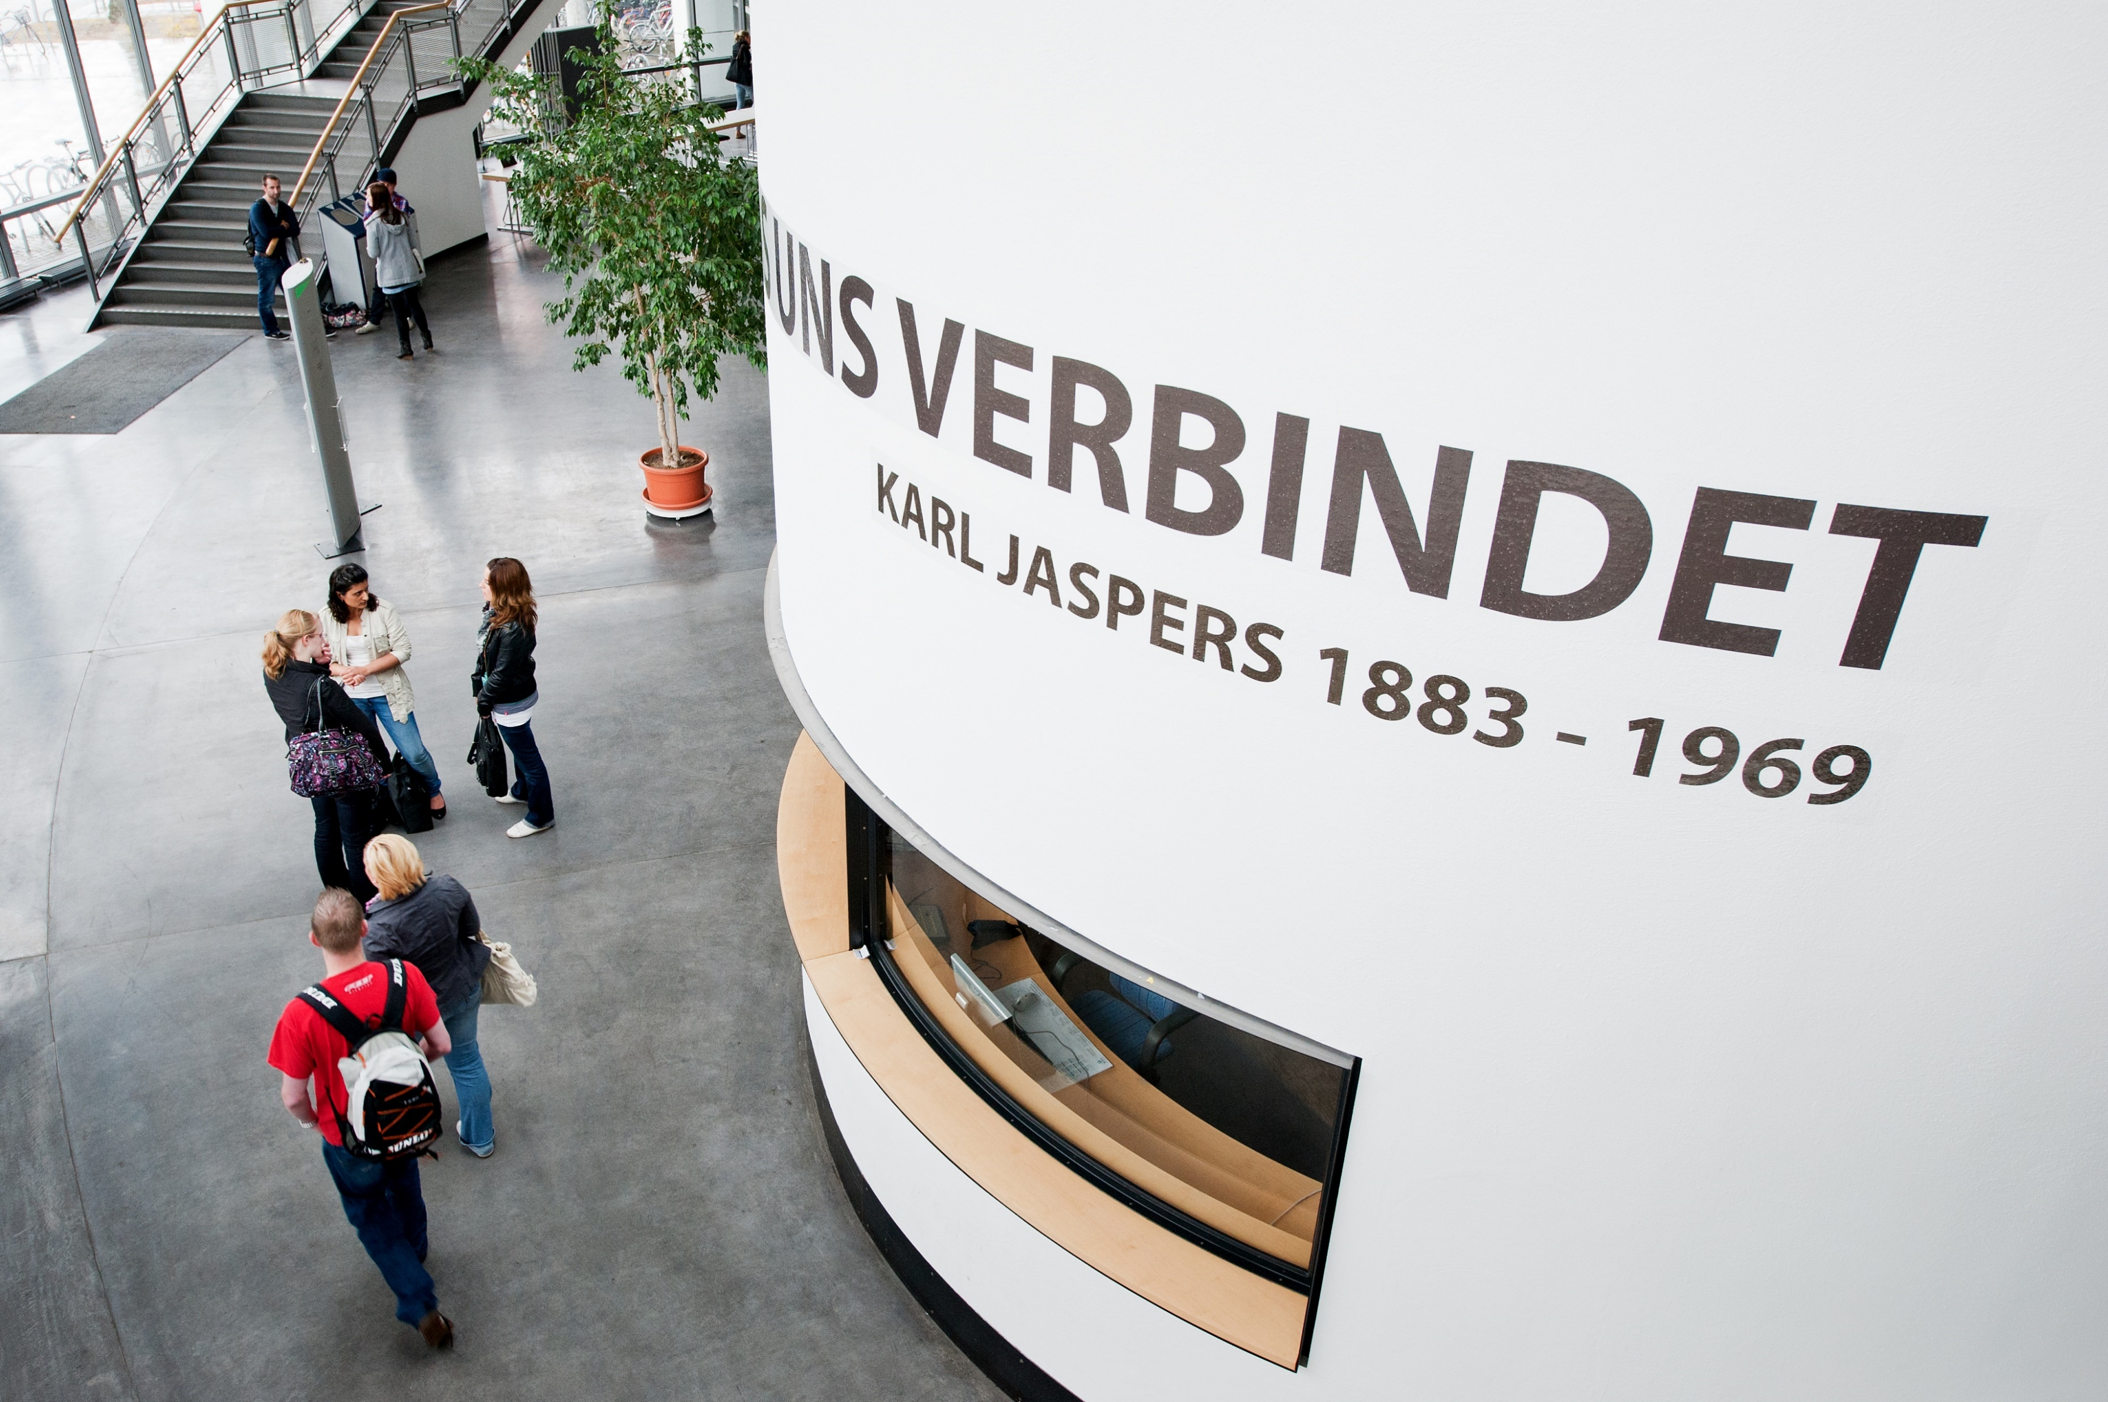
Studying in Oldenburg
Campus university
More than 100 courses of study
Interdisciplinary teaching and research
Small seminars
Friendly Atmosphere

Slide 10
Study and Career Counselling Service
Hands-on event for career orientation and career planning
Talks by experts from professional life on entry and development opportunities in their own company
Concrete offers for entering the job market with our own job and internship exchange
Career Day - the career fair of the UOL
Cooperation with internal and external institutions and regional companies
Business Networking

Slide 11
Research Profile
Environment and Sustainability
Biodiversity and Marine sciences
Sustainability
Future Energies
Human and Technology
Hearing Research
Cooperative Critical Systems
Sensory Neuroscience
Health Care Systems and Patient-Centredness
Society and Education
Diversity and Participation
Education and Social Participation
Professionalisation Processes in Teacher Education
Social Transformation and Subjectivation

Slide 12
An-Institute der Universität
BKGE – Federal Institute for the Culture and History of the Germans in Eastern Europe
ecco – ecology + communication Unternehmensberatung GmbH
Hörzentrum Oldenburg GmbH
IÖB – Institute for Economic Education gGmbH
ISN – Institute for Science Networking GmbH
DLR – Institute of Networked Energy Systems
LTP – Laboratory for Thermophysical Properties GmbH
OFFIS – Oldenburg Institute for Information Technology e.V.
Sirius Minds GmbH
ZUKUNFT.unternehmen gGmbH (formerly GIZ – Founding and Innovation Centre GmbH

Slide 13
Non-University Research Institutions on Campus
HIFMB – Helmholtz Institute for Functional Marine Biodiversity at the University of Oldenburg
Max-Planck research group Marine Isotope Geochemistry
IFAM – Fraunhofer Institute for Manufactoring Technology and Advanced Materials, Oldenburg site
IDMT – Fraunhofer Institute for Digital Media Technology, Project Group for Hearing, Speech and Audio Technology
IWES – Fraunhofer Institute for Wind Energy and Energy System Technology
DLR-Institute of Networked Energy Systems

Slide 14
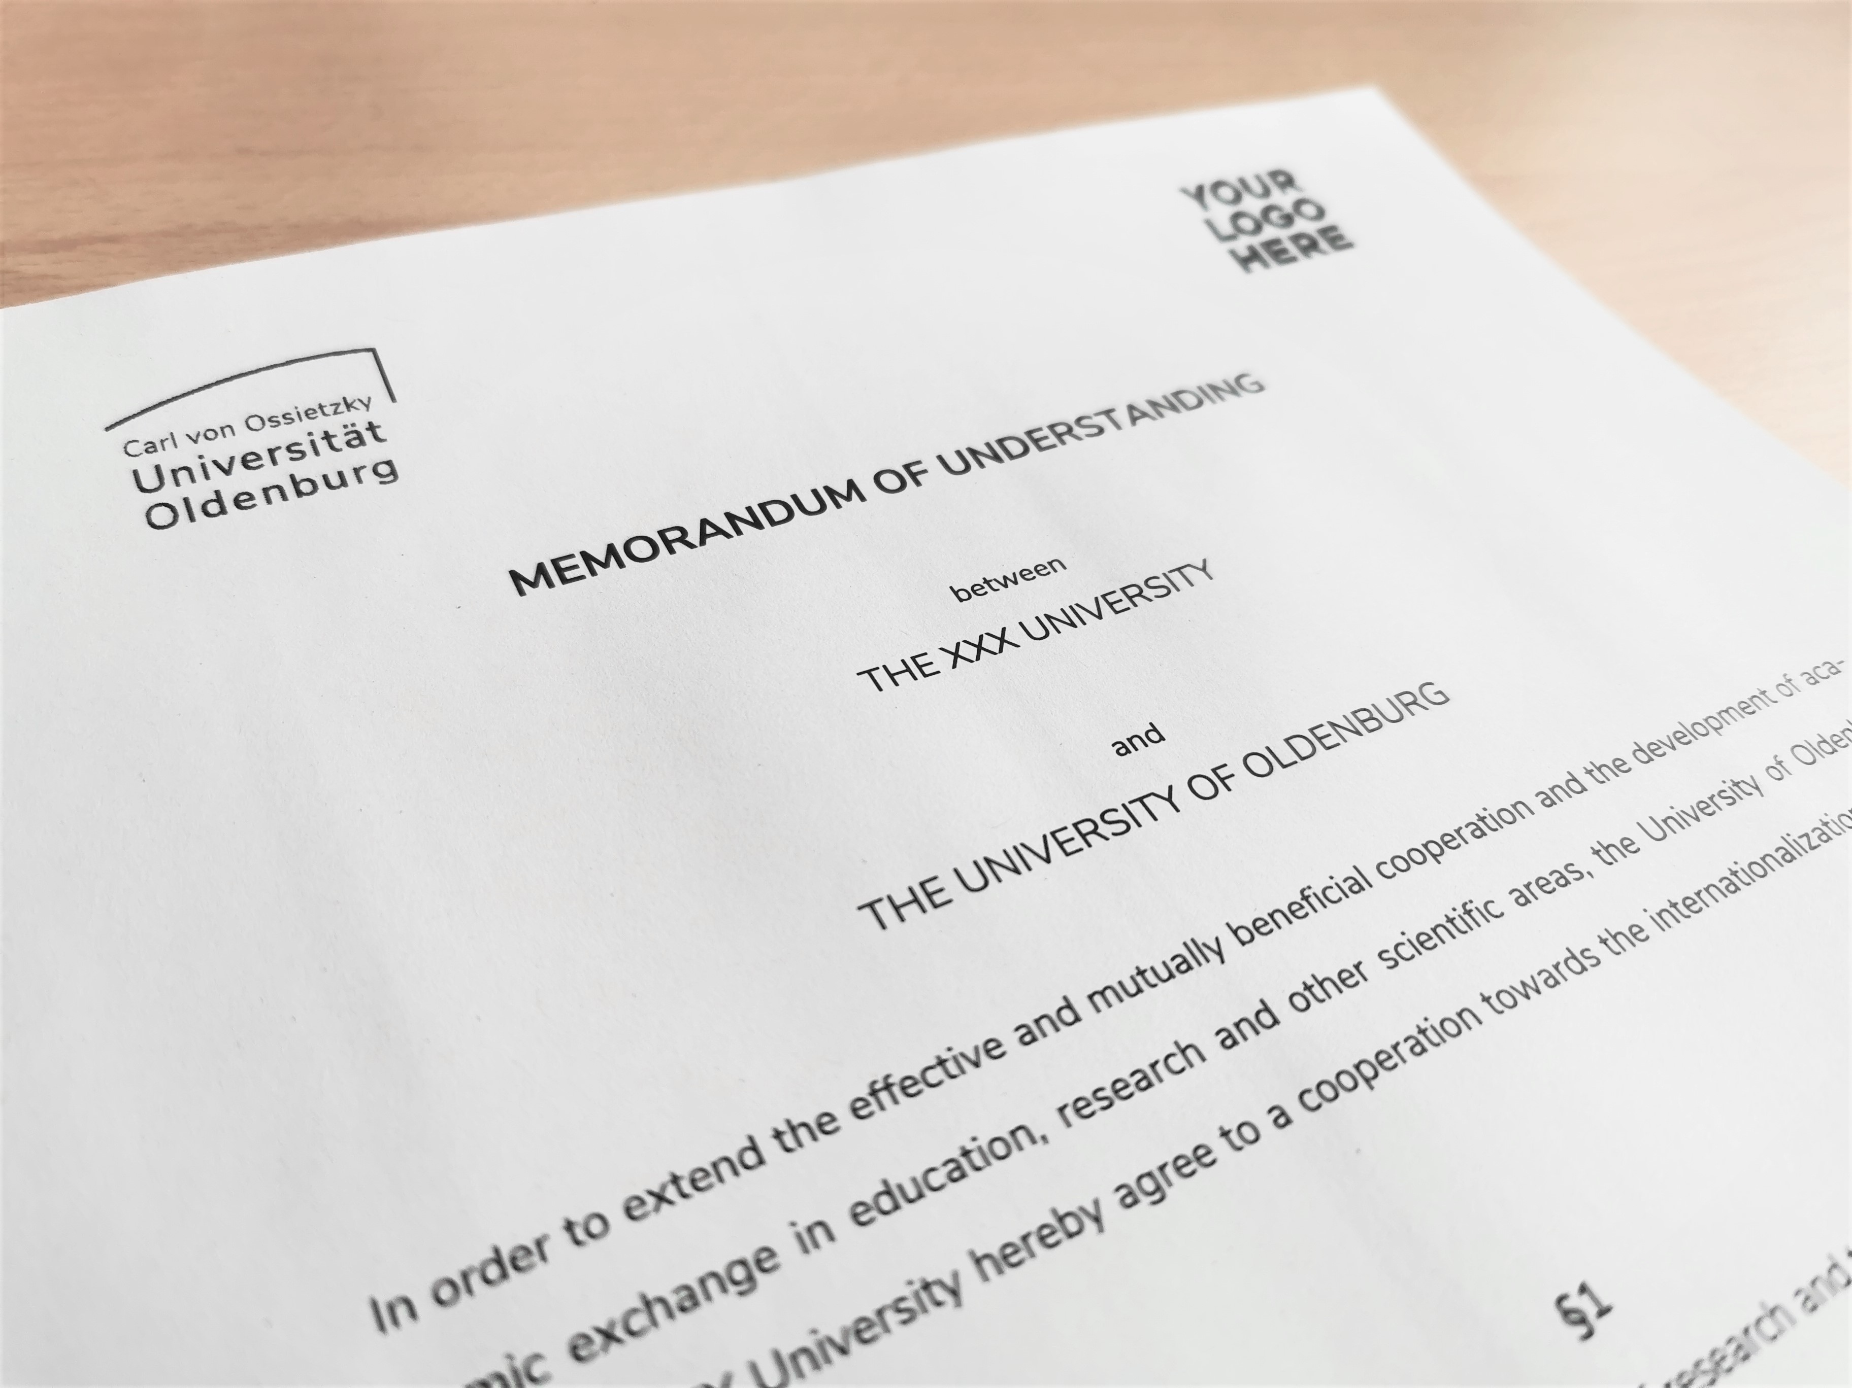
International University
more than 250 cooperation projects with universities all over the world
just below 1,300 foreign students from over 110 nations

Slide 15
Main Partner Universities
University of Groningen (the Netherlands)
Nelson Mandela University, Port Elizabeth (South Africa)

Slide 16
University Library
More than 1.3 million books and almost 300,000 e-books
30,500 electronic journals
1,420 study spaces for students, about 300 equipped with a computer
A comprehensive Multimedia Centre

Slide 17
University Sports Centre
Emphasis on recreational and amateur sport
Modern sport facilities including gyms, large and small sport fields and an indoor swimming pool
„StudiO“ – Modern fitness and health centre
Courses for students, employees and members of the public in more than 100 sports

Slide 18
University Catering
Cafeterias at the Haarentor and Wechloy campuses
Cafeteria food made using organic farming products from the region
Certified under the EU-Eco regulation since 2004
Coffee bars on Haarentor Campus and Wechloy Campus

Slide 19
#FairtradeUniversity
FAIRTRADE UNIVERSITY award since January 2022
Use of fair trade products on campus
Talks and workshops on the topic of fair trade

Slide 20
University Living
1,602 rooms and apartments in student residences
Halls of residence close to campus and the city centre

Slide 21
Culture on Campus
Oldenburg Uni Theatre „unikum“
Music Ensembles The University Orchestra The University Choir Pop- and Jazzchoir Ensemble Alte Musik European Brass Music Uni-Soulband
Uni-Big Band
World Music Ensemble
Student cinema „Gegenlicht“

Slide 22
Oldenburg
Residential city in Northwest Germany with 170,000 inhabitants
Designated Germany‘s „City of Science 2009“ by the Stifterverband – the German Donors' Association for the Promotion of Sciences and Humanities
A hub for technology and start-ups – Oldenburg is Lower Saxony‘s top location for start-ups

Slide 23
Further information www.uol.de/en

