Slide 1








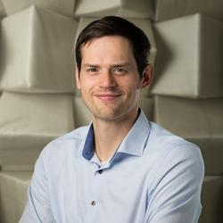







OLTECH Career paths
in Science, Medicine and Technology
Seminar series for young researchers enrolled in the PhD study programmes of the Graduate School OLTECH
Dr. Beena Punnamoottil
Dr. Florian Denk
Beena completed her PhD in 2008 in OL in the field of neuro- and developmental genetics. She worked as project manager at a contract research organization, Chimera Biotec GmbH. In 2020, she returned to the UOL as a research officer for medical research.
Deutsches Hörgeräte
Institut GmbH
Leitung Forschung und Studien
Find out about career paths for your next steps and meet OLTECH alumni
and other role models!
What is their current job like?
How did they get it?
Which skills do they need?
November 11th, 2025
4:00 – 5:30 p.m.
Hear from their experiences and interact with them
Learn about a variety of career paths
Get insights into different areas of work
In English via BigBlueButton
max. 40 participants
For more information, check out our Webpage
Registration via Stud.IP

