Slide 1
Event-Related Potentials during Cued and Voluntary Task-Switching
Henrike Welpinghus
Universität Bremen
henrike.welpinghus@gmx.de

Slide 2
Question and experiment
Which specific processes underlie voluntarily chosen actions?
Comparison between cued and voluntary task-switching
EEG measurements on 15 healthy participants (8 male, age: 23.2 ± 2.9 years)
Event-related Potentials
P3 component on parietal electrodes

Slide 3
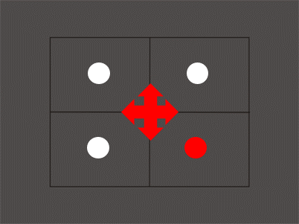
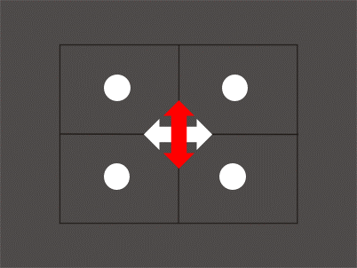
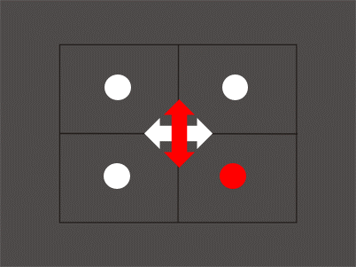
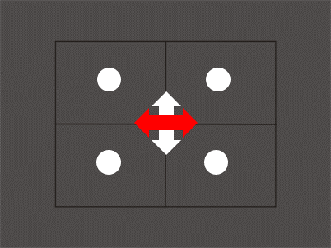
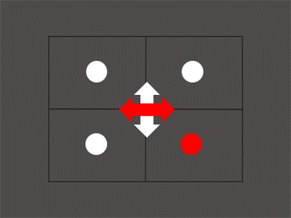
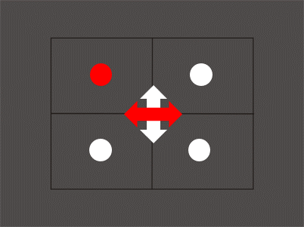
Cued condition
Voluntary condition
Switch
From horizontal to vertical task
Repeat
Horizontal task
Preparation
Execution

Slide 4
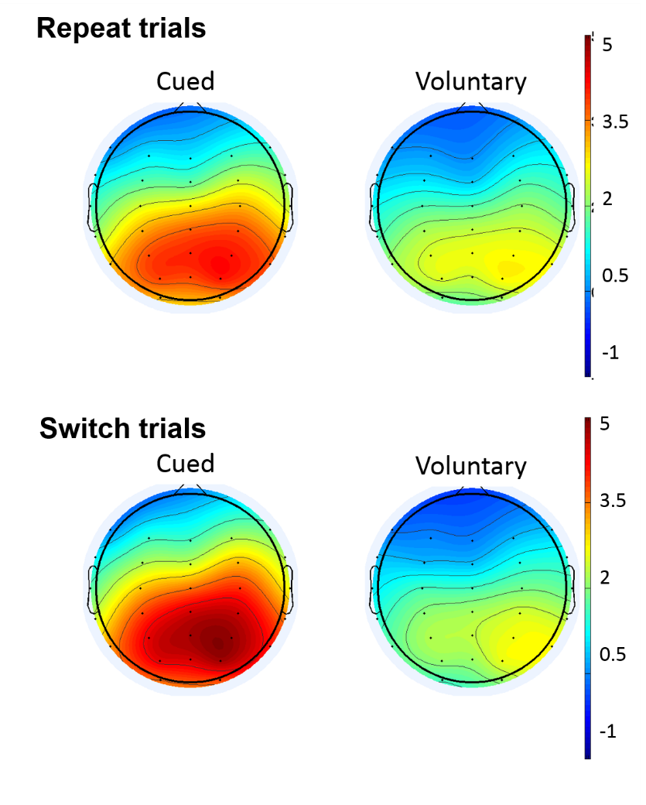
P3 component during preparation
P3 range: 300-600 ms after warning-stimulus onset
Lateralization towards right hemisphere
(F(2,28)=5.04, p=0.014)
Reduced amplitude in voluntary condition
(F(1,14)=15.49, p=0.001)

Slide 5
Discussion
Lateralization towards right hemisphere
Spatial attention (Macaluso & Doricchi, 2013)
Reduction of P3 component in voluntary condition
Higher working memory load due to additional cognitive task
Working memory increase → reduction of P3 component (Kok, 2001)
Reflecting decision-making process?
Decision might be jittered
Notes:
decide for each task equally often and in a random order

Slide 6
References
Kok, A. (2001). On the utility of P3 amplitude as a measure of processing capacity. Psychophysiology, 38(3), 557-577.
Macaluso, E., & Doricchi, F. (2013). Attention and predictions: control of spatial attention beyond the endogenous-exogenous dichotomy. Front Hum Neurosci, 7, 685. doi: 10.3389/fnhum.2013.00685

