Slide 1
Neuropsychological and brain volume differences in patients with left and right beginning Corticobasal Syndrome
K. Jütten, P. Pieperhoff, M. Südmeyer, S. Ferrea, S. Caspers, K. Zilles, A. Schnitzler,
K. Amunts, S. Lux
Plos One, in press
19. September 2014 | Prof. (apl.) Dr. Silke Lux

Slide 2
Introduction
Cortico basal syndorme (CBS) characteristics:
Describtion:
- „atypical parkinson syndrom“
- very rare (< 4:100 000)
- progressive
- begin around age 60
Background:
Previous studies did not separate
left (l-) from (r-) right beginning CBS patients
Clinical signs:
Movement impairment:
- starts unilateral (one sided)
- paucity of movement
- muscle rigidity
- tremor
Cognitive impairment:
- language symptoms
- later other cognitive symptoms
Research question:
Differences in l-CBS and r-CBS in local brain volume and cognitive functions
➔Evidence of differences in hemispheric susceptibility to disease-related changes

Slide 3
Methods
Measurements
Brain volume
Deformationfield-based
Morphometry (DBM) on
structural MRI
Cognitive functions
Neuropsychological
investigation (11 tests)
Subjects
 | l-CBS | r-CBS | controls
N | 4 | 4 | 8
Gender (m/f) | (2/2) | (2/2) | (4/4)
Age in years (SD) | 68 (9) | 68 (4) | 65 (8)
Duration in years (SD) | 3,5 (1) | 3,8 (1) | -

Slide 4
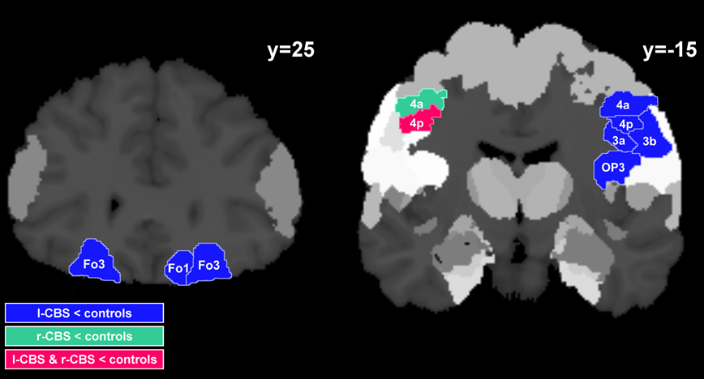
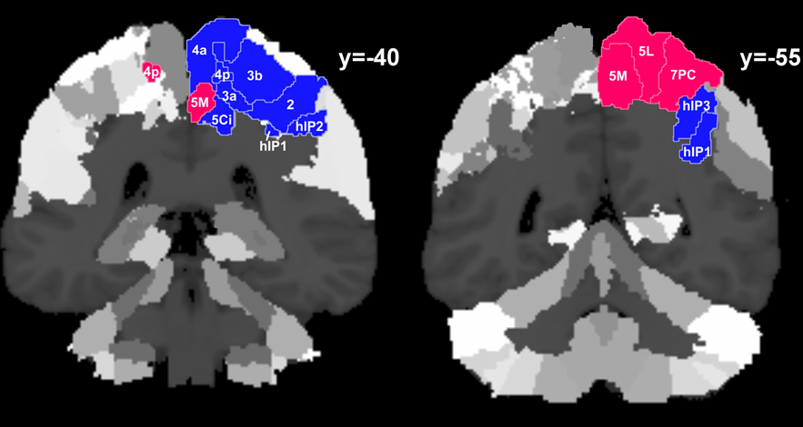
Results
Brain volume differences
Cognitive functions | l-CBS | r-CBS
Memory verbal working memory visual spatial working memory verbal episodic memory figural memory | + + - + | + + + +
Attention procession speed | + | +
Executive functions affinity of interference | + | +
Language word fluency naming | - + | + +
Perception object space | - - | + +
Motor functions apraxia left apraxia right | -- - | - --
l-CBS:
Atrophy: fronto-parietal, orbitofrontal, temporal
r-CBS:
Atrophy: predominatly fronto-parietal
NP: apraxia, memory, perceptional deficits
NP: apraxia

Slide 5
Summary and Conclusion
Left- and right-beginning CBS are differently affected with respect to brain volume reduction and extent of NP impairment
Side of clinical onset may have impact on manifestation and development of symptoms
Hemispheres might be differently able to cope with disease-related changes
Considering side of clinical onset in CBS can help to reduce the heterogeneity of clinical evidence
19.09.2014
Prof. (apl.) Dr. S. Lux

Slide 6
Methods
Function | Test
Memory
Verbal working memory | Digit-span test, Subtest of the Nürnberger-Alters Inventar
Visual-spatial working memory | Corsi Block Tapping Test (CBT)
Verbal episodic memory | Verbaler Gedächtnistest (VGT)
Figural memory | Figure test (FT) Subtest of the Nürnberger-Alters Inventar
Attention
Processing speed | Zahlen-Verbindungs-Test (ZVT-T1) German subtest of the Nürnberger-Alters Inventar
Executive functioning
Affinity of interference | Farb-Wort-Interferenz Test (FWIT)
Language
Word fluency | Controlled oral word association test (COWAT)
Naming | Naming –Subtests of the Aachener Aphasie Test
Perception
Object | Incomplete letters (IL)
Space | Number location (NL) Subtests of the Visual Object and Space Perception Battery
Motor skills
Apraxia | Florida Apraxia Screening Test (FAST)
Bildunterschrift

Slide 7
Results
Two case studies (6 months follow-up)
Brain volume differences
Body side of onset | Left CBS | Right CBS
Years of education | 9 | 10
Gender | f | f
Age at t1 | 57.6 y | 63.4 y
Duration at t1 | 3.8 y | 4.0 y
l-CBS
r-CBS
Cognitive functions:
l-CBS : worsening of verbal fluency, visuo-perception and apraxia, but especially of memory functions
r-CBS : worsening of verbal memory but especially of apraxia

