Slide 1


Memory Tasks Performance Correlates with Hippocampal Volume in amnestic MCI but not in Healthy Subjects – Some Preliminary Findings.
Mario Baglivo ¹⁾, Margarethe Korsch ^{1,2)}, Helmut Hildebrandt ³⁾, Claudia Niemann ⁴⁾, and
Manfred Herrmann ^{1,2)}
¹⁾Department of Neuropsychology and Behavioral Neurobiology, Bremen University, Germany
²⁾Center for Advanced Imaging (CAI), Bremen University, Germany
³⁾Department of Neurology, Klinikum Bremen-Ost, Bremen, Germany
⁴⁾Jacobs Center on Lifelong Learning and Institutional Development, Jacobs UniversityBremen, Germany

Slide 2
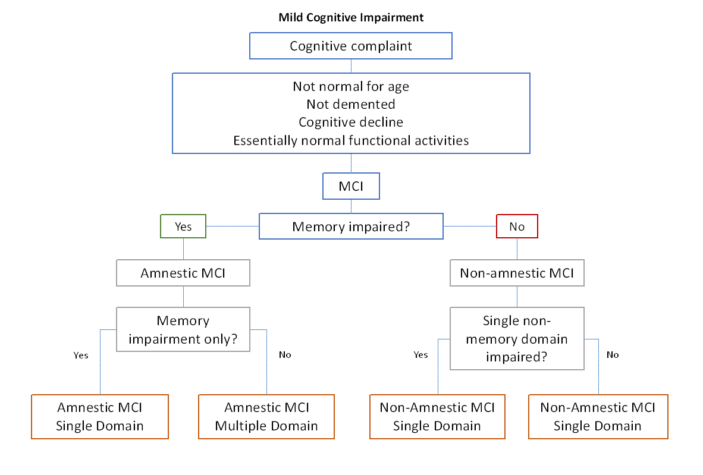
Introduction
Amnestic Mild Cognitive Impairment (aMCI) (Petersen, 2004)
Hippocampus and aMCI
with aging HC tends to shrink faster than other parts of the mediotemporal lobe such as the entorhinal cortex (EC) (Raz et al., 2004)
hippocampal atrophy might be a predictor of AD and MCI (Wolf et al., 2001)
By contrast, other studies point out that the atrophy of the HC may not be the only cause of the memory impairment (Pennanen et. Al, 2005; Shi et al., 2009) or that MRI study cannot distinguish individuals with MCI, mild AD and normal aging (Menezes et al., 2013)
Experimental questions
Are there differences in the volume of healthy elderly and aMCI patients?
Does reduced hippocampal volume correlate with performance in memory tasks?

Slide 3
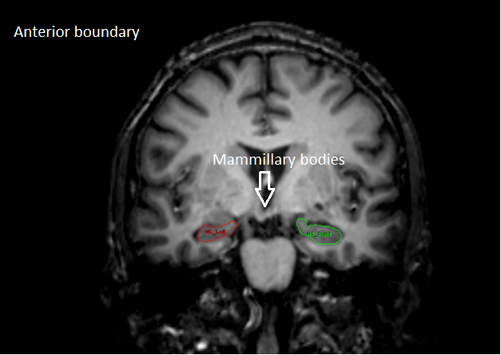
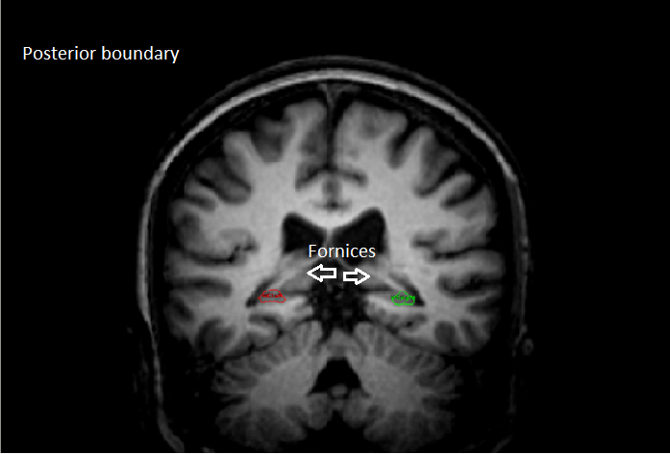
Methods
MRI data acquisition
Scans have been performed with a 3-T SIEMENS Magnetom Allegra ® System (Siemens, Erlangen, Germany).
T1‐weighted structural 3D‐image. MPRAGE : TR=2.3 s,TE=4.38 ms, flip angle=8°, TI=900 ms, 176 contiguous slicesFOV=256×256 mm, inplane resolution =1x1 mm, slice thickness=1 mm) which took approximately 8 minutes.
Participants
10 male healthy elderly (HE)
Mean age: 71 (SD=3.01)
Mean MMSE: 28.50 (SD=1.08)
9 male aMCI
Mean age: 70 (SD=3.84)
Mean MMSE: 27.78 (SD=1.85)
Verbal Learning and Memory Test (VLMT)
Learning and encoding / VLMT 1 to 5
Consolidation in Long Term Memory / VLMT 6 and 7
Recognition skills / VLMT WF
Prior to the tracing procedure:
Voxels have been resized to 0.5 mm isotropic voxel size;
Tracing reliability was assessed by computing the Intraclass Correlation Coefficient.
Criteria:
Anterior boundary: first slice where the mammillary bodies appear most bulbous.
Posterior boundary: the slice where the fornices rise from the fimbria of the HC
The volume of the hippocampus was estimated from 22-32 coronal sections (cf. Raz et al., 2004).

Slide 4
Results
Volumetric analysis
Mann-Whitney-U test:
Left HC: U=24.0, z= -1.715, p=0.086
Right HC: U=30.0, z= -1.225, p=0.221
Total: U=28.0, z=-1.388, p=0.165
Neuropsychological data
 | Descriptive statistics |  |  |  |  | T-test equality of means
 | groups | N | MEAN | SD | SE | T | Sig.(Two-tailed)
VLMT1 to 5 | HE | 10 | 41,6 | 7,442 | 2,353 | 2,765 | 0,013
 | aMCI | 9 | 33,44 | 5,028 | 1,676
VLMT6 | HE | 10 | 7,9 | 1,969 | 0,623 | 5,003 | <0.001
 | aMCI | 9 | 3,11 | 2,205 | 0,735
VLMT7 | HE | 10 | 7,6 | 2,366 | 0,748 | 4,901 | <0.001
 | aMCI | 9 | 2,78 | 1,856 | 0,619
VLMT6minus5 | HE | 10 | 2,5 | 1,9 | 0,601 | -3,039 | 0,007
 | aMCI | 9 | 5 | 1,658 | 0,553
VLMT5minus7 | HE | 10 | 2,8 | 1,814 | 0,573 | -3,181 | 0,006
 | aMCI | 9 | 5,33 | 1,658 | 0,553
VLMTW (word recognition uncorrected) | HE | 10 | 13,6 | 1,43 | 0,452 | 1,878 | 0,078
 | aMCI | 9 | 11 | 4,123 | 1,374
VLMTWF (Word recognition corrected) | HE | 10 | 10,4 | 4,061 | 1,284 | 3,871 | 0,001
 | aMCI | 9 | 3,33 | 3,873 | 1,291
HC volumes in aMCI did not differ significantly from HE
VLMT/Volumetry
Correlation [ p value (Pearson coefficient) ]
 | Healthy elderly |  |  | aMCI
 | Left HC | Right HC | HC total | Left HC | Right HC | HC total
VLMT 1-5 | 0.719 (0.130) | 0.554 (0.213) | 0.914 (0.040) | 0.034 (0.705) | 0.200 (0.476) | 0.091 (0.594)
VLMT 6 | 0.567 (0.206) | 0.999 (-0.001) | 0.705 (0.137) | <0.001(0.951) | 0.001 (0.901) | <0.001 (0.954)
VLMT 7 | 0.532 (-0.225) | 0.511 (-0236) | 0.415 (-0.291) | <0.001(0.983) | <0.001 (00.922) | <0.001 (0.980)
VLMT W | 0,370 (0,120) | 0,156(-0,356) | 0,363 (-0,127) | 0,011(0,744) | 0,039 (0,614) | 0,019 (0,694)
VLMT WF | 0.494 (0.246) | 0.610 (-0.185) | 0.881 (0.054) | 0.007 (0.815) | 0.002 (0.884) | 0.002 (0.883)
Significant correlation between performance in VLMT and HC volumen has been found only in aMCI patients
Differences in Rey Figure test, MWT, TMT, digit span, block span, TAP (alertness, divided attention), and RWT were not significant

Slide 5
Discussion
No difference has been found between the hippocampi of HE and aMCI
Previous studies found no volume differences between aMCI and HE (Jauhiainen et al., 2009)
More recent studies demonstrated how hippocampal subfield volumetry of CA1 (Cornu Ammonis) was more accurate than global HC measurement by distinguishing aMCI from HE (La Joie et al., 2013)
Gerardin et al. (2009) were able to individually classify AD, MCI and controls with high accuracy by use of multidimensional classification of shape features
In the present cross-sectional study performance in VLMT significantly correlate with HC volume only in individuals with aMCI
This finding suggests that memory performance of individuals with aMCI is more susceptible to structural deterioration
Research on animal model (Gold et al., 2013) as well as functional studies (Reitz et al., 2009) corroborate the hypothesis of a metabolic dysfunction of the HC in aMCI
Changes of cognitive strategies in elderly might occur, accompanied by the recruitment of other brain areas
Burgmans et al. (2010) observed the involvement of prefrontal cortex, cuneus and cerebellum along the deactivation of HC and other mediotemporal regions
Further suggestions on the shift from HC to prefrontal regions are provided by Rajah et al. (2010)
The reasons of the poorer memory performance of aMCI subjects could be related to an insufficient metabolic functioning and/or to the lack of compensatory mechanisms

Slide 6
References
Gerardin, E., Chetelat, G., Chupin, M., Cuingnet, R., Desgranges, B., Kim, H.-S., … Colliot, O. (2009). Multidimensional classification of hippocampal shape features discriminates Alzheimer’s disease and mild cognitive impairment from normal aging. NeuroImage, 47(4), 1476–1486.
Gold, P. E., Newman, L. A., Scavuzzo, C. J., & Korol, D. L. (2013). Modulation of multiple memory systems: From neurotransmitters to metabolic substrates. Hippocampus, 23(11), 1053–1065.
Grundman, M., Sencakova, D., Jack, C. R., Petersen, R. C., Kim, H. T., Schultz, A., … van Dyck, C. (2002). Brain MRI hippocampal volume and prediction of clinical status in a mild cognitive impairment trial. Journal of Molecular Neuroscience, 19(1-2), 23–27.
Jauhiainen, A. M., Pihlajamäki, M., Tervo, S., Niskanen, E., Tanila, H., Hänninen, T., … Soininen, H. (2009). Discriminating accuracy of medial temporal lobe volumetry and fMRI in mild cognitive impairment. Hippocampus, 19(2), 166–175.
La Joie, R., Perrotin, A., de La Sayette, V., Egret, S., Doeuvre, L., Belliard, S., … Chételat, G. (2013). Hippocampal subfield volumetry
Menezes, T. L., Andrade-Valença, L. P. A., & Valença, M. M. (2013). Magnetic resonance imaging study cannot individually distinguish individuals with mild cognitive impairment, mild Alzheimer’s disease, and normal aging. Arquivos de Neuro-Psiquiatria, 71(4), 207–212.
Petersen, R. C. (2004). Mild cognitive impairment as a diagnostic entity. Journal of Internal Medicine, 256(3), 183–194
Rajah, M. N., Kromas, M., Han, J. E., & Pruessner, J. C. (2010). Group differences in anterior hippocampal volume and in the retrieval of spatial and temporal context memory in healthy young versus older adults. Neuropsychologia, 48(14), 4020–4030.
Raz, N., Rodrigue, K. M., Head, D., Kennedy, K. M., & Acker, J. D. (2004). Differential aging of the medial temporal lobe a study of a five-year change. Neurology, 62(3), 433–438.
Reitz, C., Brickman, A. M., Brown, T. R., Manly, J., DeCarli, C., Small, A., & Mayeux, R. (2009). LInking hippocampal structure and function to memory performance in an aging population. Archives of Neurology, 66(11), 1385–1392.
Wolf, H., Grunwald, M., Kruggel, F., Riedel-Heller, S. G., Angerhöfer, S., Hojjatoleslami, A., … Gertz, H.-J. (2001). Hippocampal volume discriminates between normal cognition; questionable and mild dementia in the elderly. Neurobiology of Aging, 22(2), 177–186. doi:10.1016/S0197-

