Slide 1
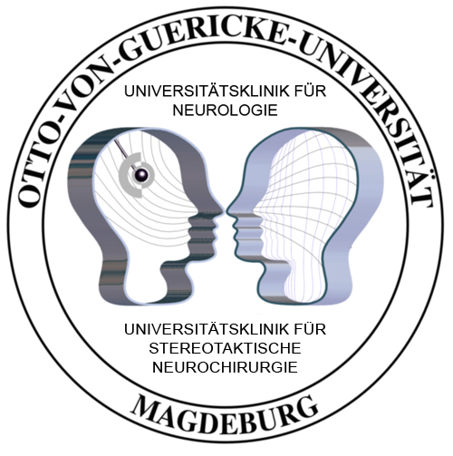
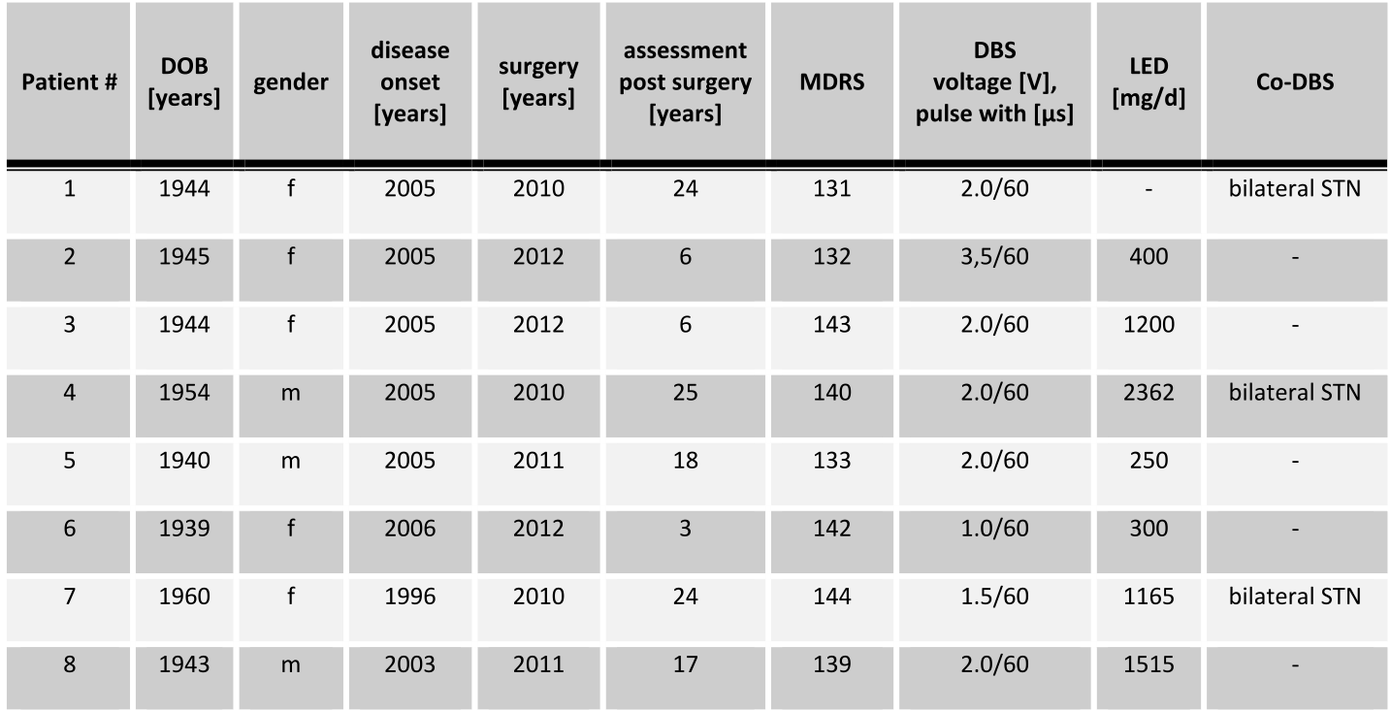
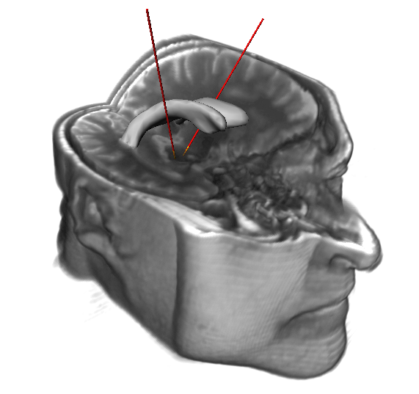
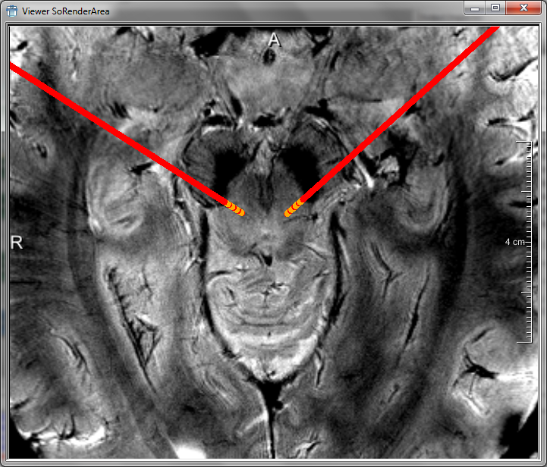
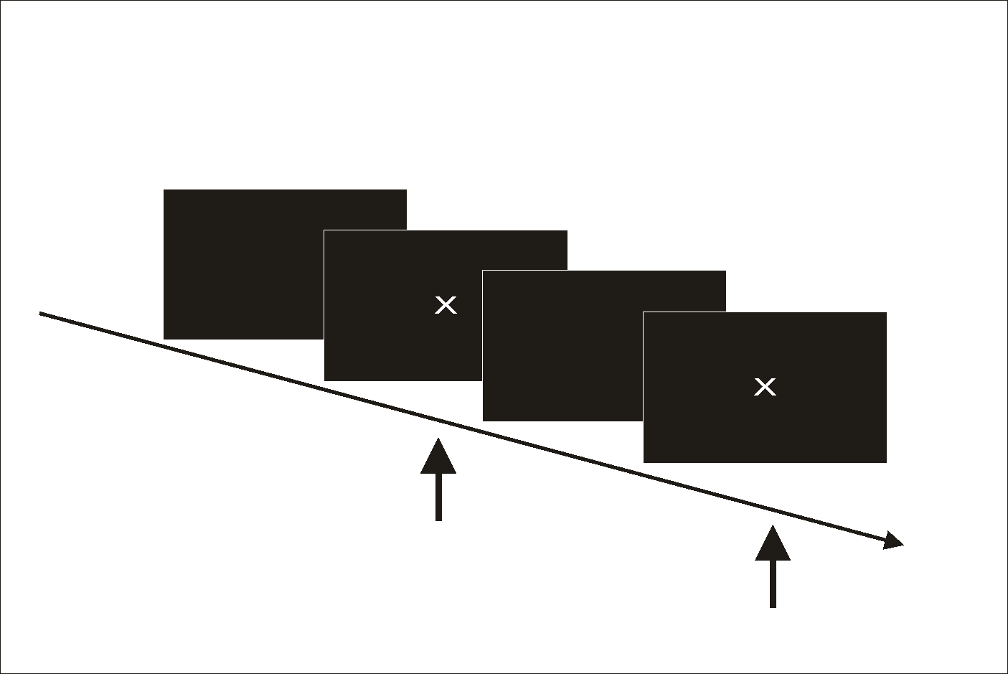
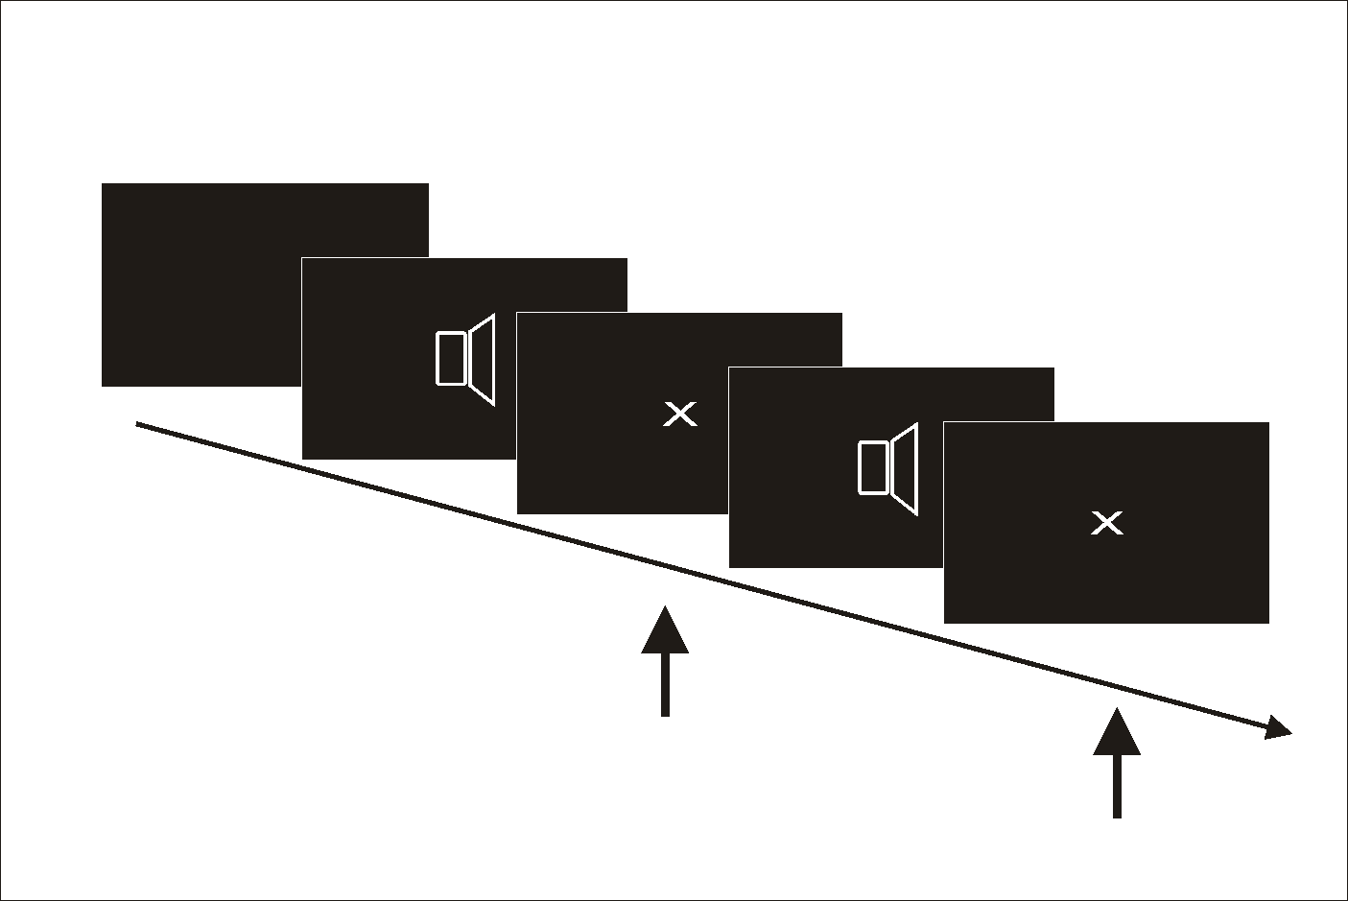
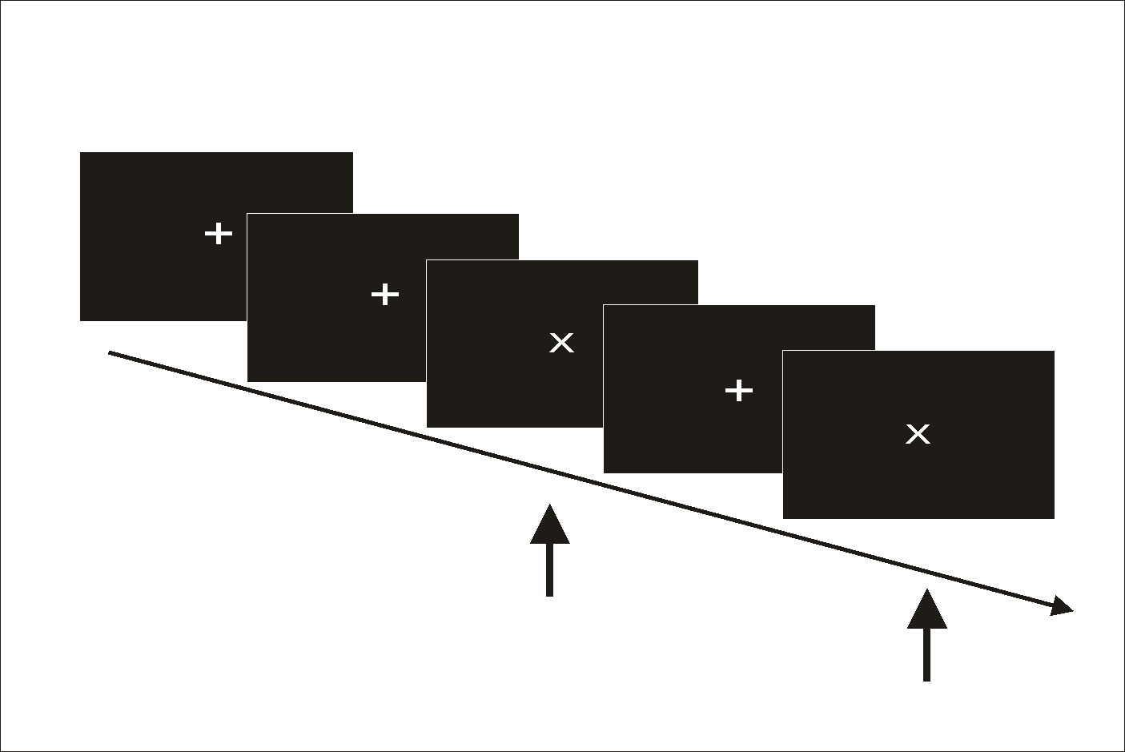
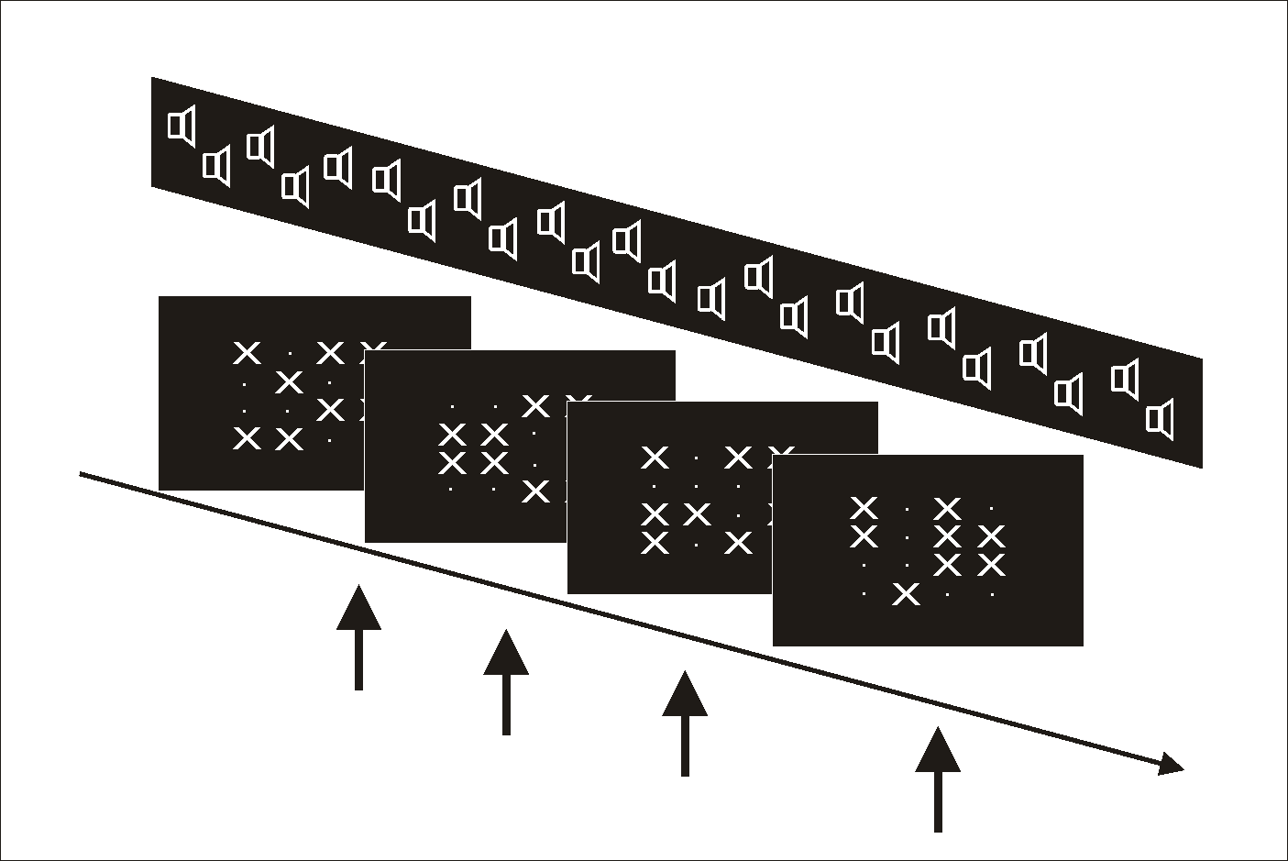
Modulation of attentional processing by deep brain stimulation of the pedunculopontine nucleus in patients with parkinsonian disorders
Julia Fischer, Kati Schwiecker, Verena Bittner, Imke Galazky, Hans-Jochen Heinze, Jürgen Voges, Tino Zaehle
Departments of Neurology and Stereotactic Neurosurgery, Otto-von-Guericke University, Leipziger Straße 44, 39120 Magdeburg, Germany
Objective:
Results:
Stimulation of the pedunculopontine nucleus (PPN) is a novel therapy, aiming to reduce motor symptoms like freezing of gate (FOG) and postural instability in parkinsonian disorders [1,2,3]. Since the PPN is a component of the reticular activating system, it might have an important role in regulating states of attention and consciousness [4, 5, 6]. As attentional deficits may contribute to the final motor dysfunction [7, 8), one potential mechanism by which PPN stimulation might improve motor symptoms is attentional augmentation [9].
In the present study we systematically investigated the influence of PPN-stimulation at 5 stimulation frequencies on attentional processing in standard reaction time tasks.
Alertness-Task (unwarned condition) results reveal a significant improvement of reaction times at 8 Hz and 20 Hz (Fig. A)
Methods:
We included eight patients diagnosed with parkinsonian disorders.
Table 1: Demographic and clinical characteristics of patients
All patients were implanted with electrodes (DBS Lead Model 3389) in the bilateral PPN
No systematic stimulation dependent variation in the performance of the go-/nogo (Fig. A) and the divided attention task [Fig. B-C] could be observed.
Conclusion
Patients performed three standard reaction time tasks (Alertness-Task; Go/NoGo-Task; Divided-Attention-Task; TAP 2.2) at 5 different stimulation frequencies (off, 8Hz, 20HZ, 60Hz, 130Hz). All patients were instructed to respond as fast as possible to appearing visual and auditory stimuli by pressing a response button.
Low-frequent stimulation of PPN improves basal attentional processing in patients with PD, leading to an improved tonic alertness. As successful performance in this task requires the intrinsic ability to build up and keep a certain level of attention, this might be interpreted as attentional augmentation due to stimulation features. Stimulation had no effect on more complex attentional processing. Our results suggest an influence of the PPN on certain aspects of attention, supporting attentional augmentation as one possible mechanism to improve motor action and gait in patients with PD.
References:
Giladi N, Hausdorff JM. The role of mental function in the pathogenesis of freezing of gait in Parkinson’s disease. J Neurol Sci 2006; 248: 173-6
Mena-Segovia J, Sims HM, Magill PJ, et al. Cholinergic brainstem neurons modulate cortical gamma activity during slow oscillations. J Physiol 2008; 586: 2947-60
Mesulam MM, Geula C, Bothwell MA, et al., Human reticular formation: cholinergic neurons:Of the pedunculopontine and laterodorsal tegmental nuclei and some cytochemical comparisons to forebrain cholinergic neurons. J Comp Neurol 1989; 283:611-33
Moro E, Hamani C, Poon YY, et al. Unilateral pedunculopontine stimulation improves falls in Parkinson’s disease. Brain 2010; 133: 215-24
Stefani A, Lozano AM, Peppe A, et al. Bilateral deep brain stimulation oft the pedunculopontine and subthalamic nuclei in severe Parkinson’s disease. Brain 2007; 130: 1596-607.
Thevathasan W, Silburn PA, Brooker H, et al. The impact of low-frequency stimulation of the pedunculopontine nucleus region on reaction time in parkinsonism. J Neurol Neurosurg Psychiatry 2010; 81: 1099-1104
Weinberger M., Hamani C., Hutchison WD, et al. Pedunculopontine nucleus microelectrode recordings in movement disorder patients. Exp Brain Res 2008; 188: 165-74
Winn P. How best to consider the structure and function of the pedunculopontine tegmental nucleus: evidence from animal studies. J Neurol Sci 2006; 248:234-50
Yogev-Seligmann G, Hausdorff JM, Giladi N. The role of executive function and attention in gait. Mov Disord 2008; 23: 329-42
Alertness-Task
(unwarned condition)
Alertness-Task
(warned condition)
Go-/NoGo-Task
Divided-Attention-Task

